Slide 1
IMPLEMENTATION OF LOW LATENCY RISC V BASED FPU IP A Presentation presented to National Institute of Technology, Agartala for the award of the degree of MASTER OF TECHNOLOGY by ARIT KUMAR GHOSH (EN – 21PEC006)
Under The Guidance Of
DR. KAMALESH DEBNATH
Department Of Electronics And Communication Engineering
National Institute Of Technology, Agartala
December 2022

Slide 2
Introduction
RISC-V is provided under open source licenses that do not require fees to use.
RISC-V is an open source microprocessor platform that currently gains popularity in many domains. Included among its modules a floating-point unit (FPU) can be found, intended for use in high-end microprocessors.
FPU perform different floating point arithmetic operations.
RISC V support many floating point arithmetic instruction.
Foe example - FADD,FSUB,FMUL,FDIV,FMA etc.
RISC-V defines a separate register file for FP instructions.
Floating point unit(FPU) will act as a co processor.

Slide 3
LITERATURE REVIEW
Hani Saleh, Earl E. Swartzlander, Jr. suggests a floating-point fused add-subtract unit is described that performs simultaneous floating-point add and subtract operations on a common pair of single-precision data in about the same time.
Felix Kaiser , Stefan Kosnac, Ulrich Bruning proposed designed a Fused Multiply-Add Floating Point Unit compatible with the RISC-V ISA in System Verilog, which enables us to conduct detailed optimizations where necessary.
Soumya Havaldar, gives an FPGA Based High Speed IEEE-754 Double Precision Floating Point Adder Using Verilog.
Ross Thompson, trade of between range, precision of IEEE-754 floating point operations.
Ramesh, A.P., Tilak, A.V.N. and Prasad, A.M. researched on the Floating Point multiplication is widely used in large set of scientific and signal processing computation.

Slide 4
OBJECTIVES
To understand how to represent floating point numbers in the computer and how to perform arithmetic with them.
To optimize the resources used while computation.
To provide hardware support for floating point arithmetic operations.

Slide 5
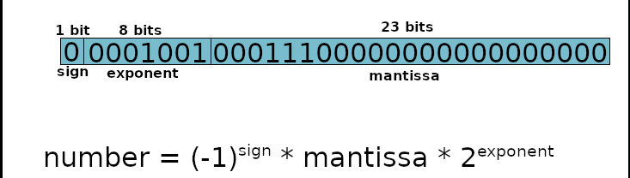
IEEE 754 Single precision floating point numbers
The sign of the Mantissa - This is as simple as the name. 0 represents a positive number while 1 represents a negative number.
The Biased exponent –The exponent field needs to represent both positive and negative exponents. A bias is added to the actual exponent in order to get the stored exponent.
The Normalised Mantissa –The mantissa is part of a number in scientific notation or a floating-point number, consisting of its significant digits.

Slide 6
Advantages of IEEE 754 Standard
Used predominantly by the industry
Encoding of exponent and fraction simplifies comparison
Integer comparator used to compare magnitude of FP numbers
Includes special exceptional values: NaN and ±∞
Special rules are used such as:
0/0 is NaN, sqrt(–1) is NaN, 1/0 is ∞, and 1/∞ is 0
Computation may continue in the face of exceptional conditions.

Slide 7
Floating point adder
FMA (Fused multiply-add) is a technical term representing the floating-point operation performed multiplication and addition in one step.
Unlike separating multiplication and additional operation, it achieves higher performance and numerical precisions due to parallel processing.
R=(A∗B)+C
Here R is the 32 bit single precision output & A,B,C are the 32 bit single precision inputs.

Slide 8
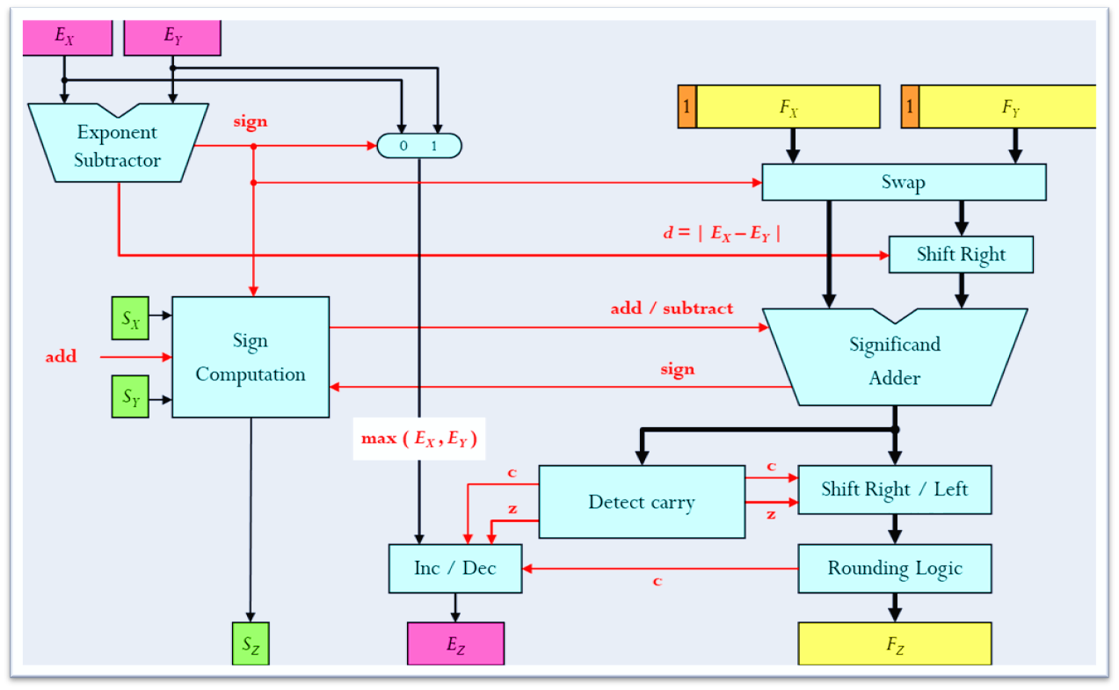
SINGLE PRECISION FLOATING POINT ADDER BLOCK DIAGRAM

Slide 9
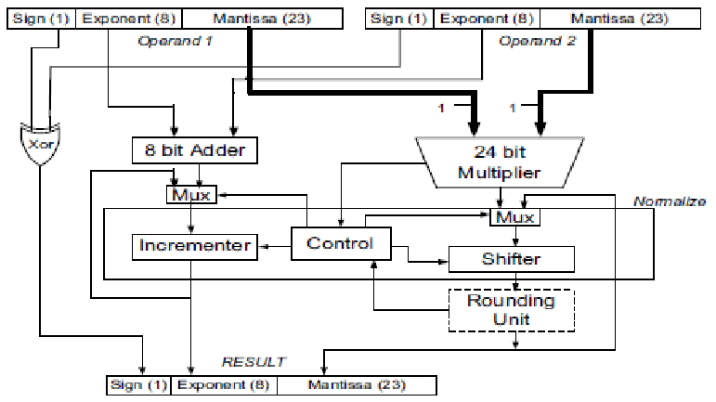
SINGLE PRECISION FLOATING POINT MULTIPLIER BLOCK DIAGRAM

Slide 10
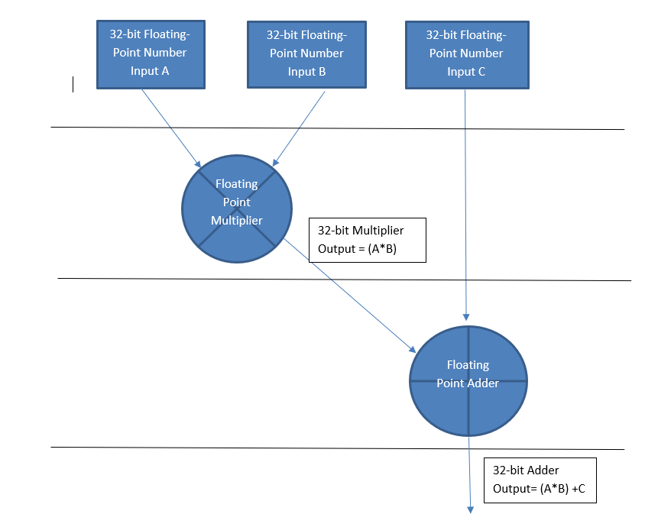
FMA simplified diagram

Slide 11
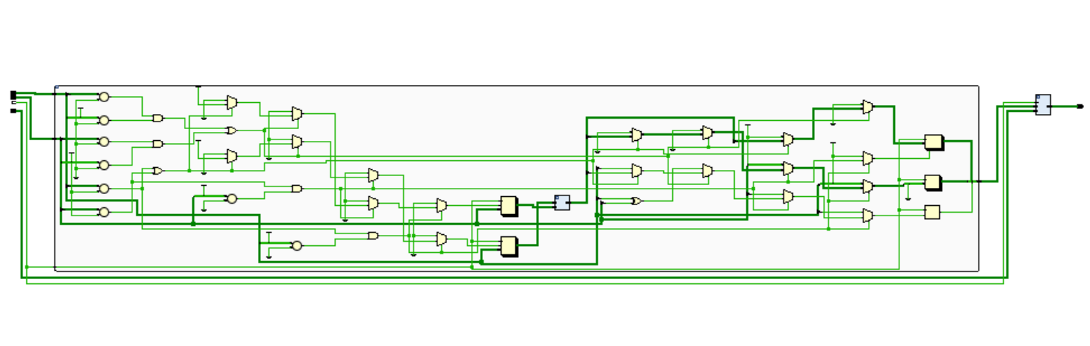
FMA ELABORATED DESIGN

Slide 12
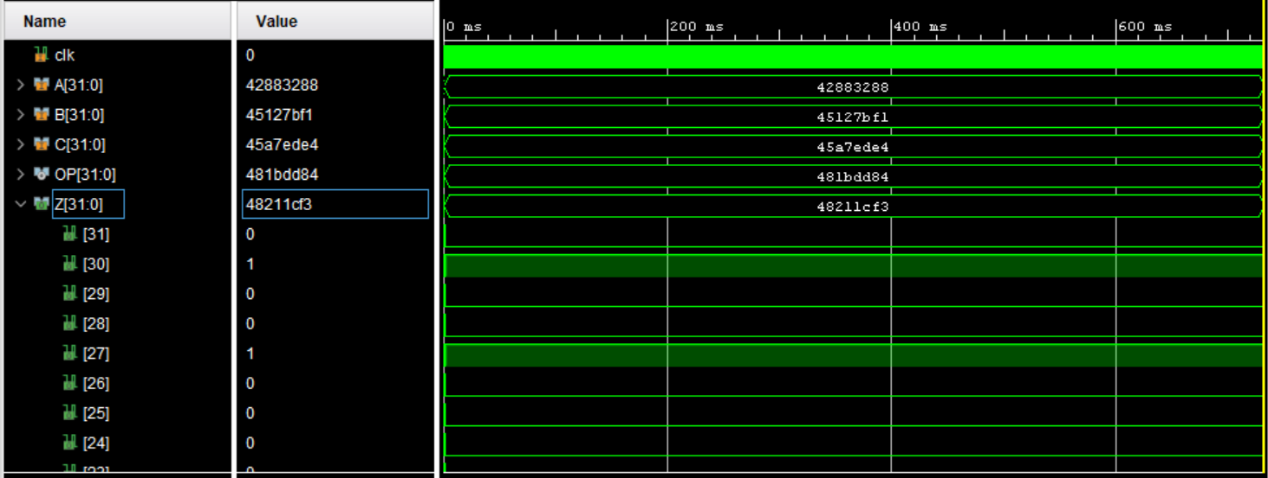
FMA OUTPUT WAVEFORM

Slide 13
FMA RESULTS
Input A (32 bit) (Decimal/Hexadecimal) | Input B(32 bit) (Decimal/Hexadecimal) | Input C (32 bit) (Decimal/Hexadecimal) | Multiplication Output OP (32 bit) = (A*B) (Decimal/Hexadecimal) | Addition Output Z(32 bit) = (A*B) + C (Decimal/Hexadecimal)
18.4576/4193A92A | 6353.373/45C68AFB | 290.570/439148F5 | 117268.0174848/47E50A02 | 117558.5874848/47E59B4B
74.000/42940000 | 234.009/436A024D | 45.9801/4237EB9F | 17316.666/46874954 | 17362.6461/4687A54A
59.36/426D70A3 | 35.345/420D6147 | 107.34/42D6AE14 | 2098.0792/45032144 | 2205.4192/4509D6B5
908.435/44631BD7 | 1334.456/44A6CE97 | 947.03/446CC1EB | 1212266.53636/4993FB54 | 1213213.56636/499418EC

Slide 14
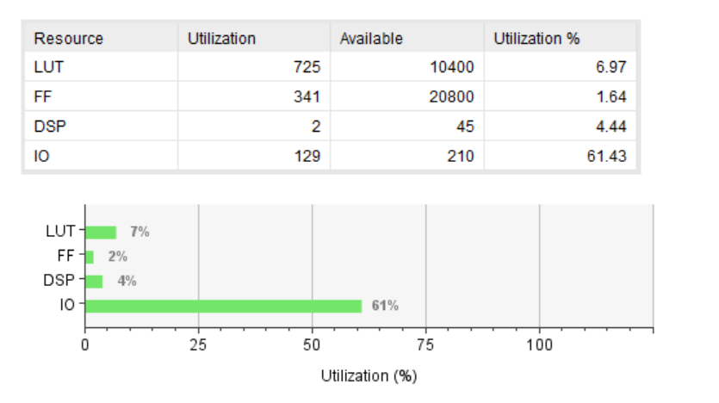
RESOURCE UTILIZATION
Selected device: xa7a15tcsg324-2I

Slide 15
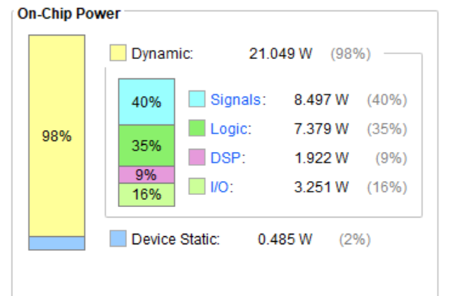
Power utilization
Selected device: xa7a15tcsg324-2I

Slide 16
Conclusion
The proposed algorithm of floating point FMA is implemented.
Individual floating point operation is designed and implemented to achieve effective resource utilization.

Slide 17
FUTURE SCOPE
To design and implement an algorithm of floating point FMSUB, Min-max.
Work to reduce the utilization of resources while implementation.
Integrate all the different IP’s and Interface the FPU with RISC V.

Slide 18
ReferenceS
D. H. Bui, D. Puschini, S. Bacles-Min, E. Beigné, and X. T. Tran. Ultra lowpower and lowenergy 32-bit datapath aes architecture for iot applications. In 2016 International Conference on IC Design and Technology (ICICDT), pages 1–4, June 2016
Al-Eryani J 2006, ‘IEEE Standard 754 for Binary Floating-Point Arithmetic’, Floating Point Unit, pp. 3-9. Available from: [01 April 2019].
M. K. Jaiswal and R. C. C. Cheung, “High Performance FPGA Implementation of Double Precision Floating Point Adder/Subtractor”, in International Journal of Hybrid Information Technology, vol. 4, no. 4, (2011) October
Goldberg D 1991, What Every Computer Scientist Should Know About Floating-Point Arithmetic. Available from: <https://www.itu.dk/~sestoft/bachelor/IEEE754_article.pdf>. [01 April 2019].
IEEE Standard for Floating-Point Arithmetic. IEEE Std 754-2008, pages 170, Aug 2008.
Ronan Barzic and Jean-Baptiste Brelot. NanoRV32 - GitHub repository. https://github.com/rbarzic/nanorv32, 2016. Online, accessed 2017- 11-15.
RISC-V Foundation. RISC-V Foundation - about. http://riscv.org/ riscv-foundation. Online, accessed 2017-11-24.

Slide 19
THANK YOU

